Slide 2
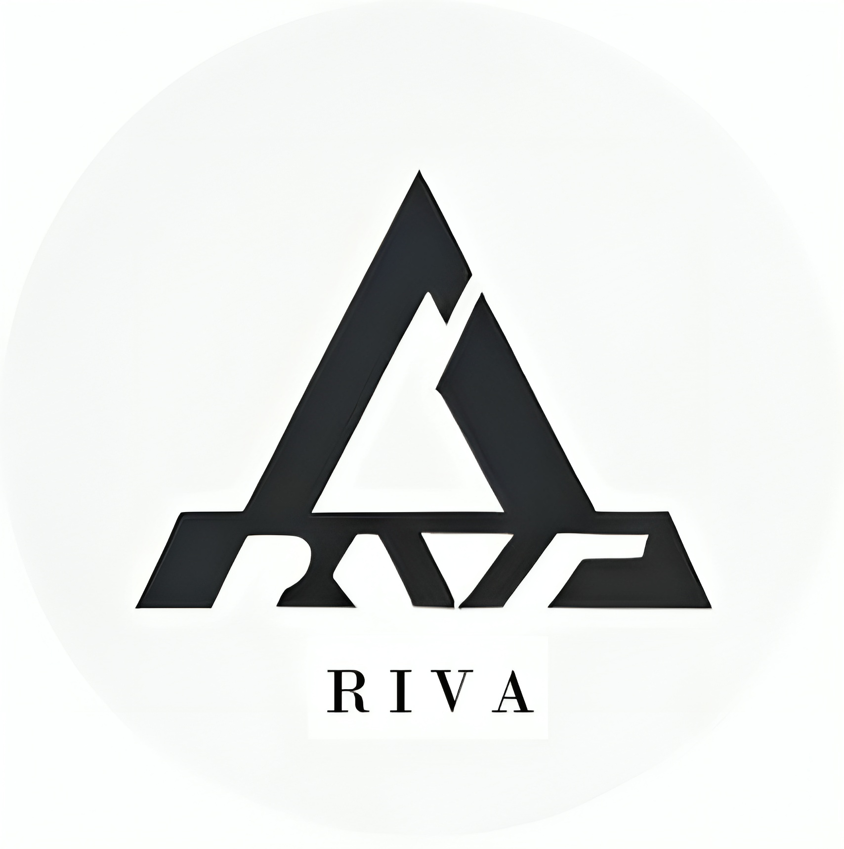
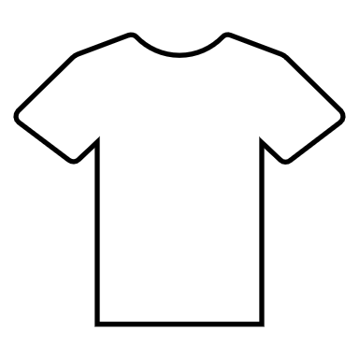

Slide 3
RIVA
REAL TIME INTELLIGENT VISION ASSISTANT

Slide 4

REAL TIME VISION ASSISTANT
PROBLEM STATEMENT
Blind individuals face significant challenges navigating their surroundings independently due to the limitations of traditional mobility aids. Existing solutions lack the dynamic, personalized assistance needed to efficiently navigate unfamiliar environments, leading to safety hazards and reduced independence.
SOLUTION
Vegan and cruelty-free materials.
Sustainable and eco-friendly practices.
Exclusive, limited-edition designs.
Uncompromising quality and craftsmanship.
Ethical labor and production processes.
A commitment to luxury, elegance, and fashion-forward thinking.

Slide 5
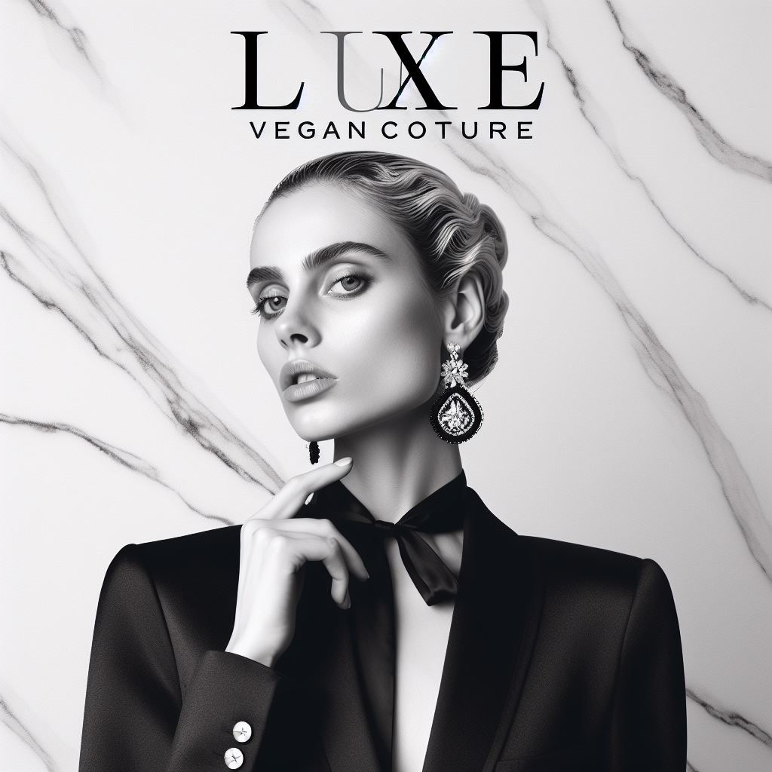
ABOUT OUR PRODUCT
PRODUCT DESCRIPTION
LuxeVegan Couture’s products include dresses, tops, pants, skirts, jackets, coats, sweaters, and accessories, all designed with a modern and elegant aesthetic that reflects the brand’s values of compassion, innovation, and excellence and are produced in the most sustainable methods.
SIZE OF THE PRODUCT
We are a brand that value and consider all our customers, so in order to reach out and suit them we offer a wide range of body types and preferences.

Slide 6
ABOUT OUR PRODUCT
COLOUR
As we are vegan brand solely emphasizing on sustainability, we will be using plant-based dyes, and our products will be available in most of the shades. We also provide custom dying options for custom orders if a customer want to tweak and have a more personal choice.
LABELLING
For labelling our products, we need to comply with the Australian requirements for clothing and textiles, which are set by the Consumer Goods (Care Labelling) Information Standard 2023. This standard specifies that all products must have adequate care labelling instructions attached to them, in English and in prominent and legible characters.
PACKAGING
We are planning to pack and mail our products in an eco-friendly mailer that are made from recycled and compostable materials, such as paper, cardboard, or plant-based plastics. These mailers are lightweight, durable, and easy to use, and they can reduce your environmental impact and carbon footprint.

Slide 7
TARGET MARKET
GEOGRAPHICAL
LOCATION
POPULATION &
DEMOGRAPHICS
MAIN IMPORTS TO
AUSTRALIA
Australia is a country with a diverse geography, with deserts, mountains, forests, grasslands, and coral reefs. It has six states and two major territories, and its capital is Canberra.
The population and the demographic of Australia is unique and diverse. Most of its residents are in the urban areas of the country. The most popular cities are Sydney, Melbourne, Brisbane, Perth, and Adelaide, with Sydney being the most populous city. The top 10 of the total population constitutes to the most wealthiest of them all.
The major imports include Fuel, Vehicles, Machinery, Tech Components, Iron etc. Even though the clothing industry isn’t one of the top importing sector it still has a net value of 11.5 billion in clothing and texting industry imports which is a pretty decent percentage.

Slide 8

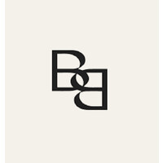
TWO COMPETITORS
ETIKO
BHUMI
ETIKO, established by Nick Savaidis in Melbourne, Australia, in 2005, emerged from a noble vision: to offer clothing and footwear that upheld ethical standards, free from child labor and exploitation while preserving the environment. Recognizing the absence of such brands in the market, Nick embarked on a journey to fill this gap. Through the establishment of fair, transparent, and eco-friendly supply chains, ETIKO has played a pivotal role in supporting the human rights and labor conditions of numerous workers across India, Sri Lanka, and Pakistan involved in cotton cultivation, rubber tapping, apparel manufacturing, shoemaking, and sports ball production. This commitment extends to positively impacting the lives of workers' families and their broader communities.
Bhumi, founded by Dushyant and Vinita based in Melbourne, Australia, originated from a profound realization of the detrimental effects of conventional cotton farming on the environment and workers. Vinita, with a background in Health and International Public Health, witnessed the devastating impact of traditional cotton growing, including farmer hardships, child labor, and environmental degradation. Motivated by a vision to evoke positive change, Vinita merged her passion for sustainability and design, birthing Bhumi Organic Cotton. Supported by Dushyant's drive for socially conscious enterprises and his finance-tech background, Bhumi expanded into a global platform. Their mission revolves around producing organic cotton bedding, bath, and basics that not only feel good but also champion sustainable practices.

Slide 9
TWO COMPETITORS
ETIKO
BHUMI
ETIKO is known for its ethically produced clothing and footwear. Their product range includes various types of clothing such as t-shirts, pants, socks, and footwear like sneakers and sandals. They prioritize fair trade, ethical manufacturing, and environmentally sustainable materials in their products. The sizes of their clothing typically range from extra small to extra large, catering to various body types.
As for BHUMI, they specialize in organic cotton bedding, bath linens, basics, and sleepwear. Their bedding includes sheets, duvet covers, and pillowcases in different sizes like single, double, queen, and king. Bath products consist of towels, bathrobes, and bathmats. Their clothing offerings include sleepwear and loungewear. Bhumi emphasizes GOTS certified fairtrade organic cotton in their products, ensuring no harmful chemicals, fair labor practices, and environmentally friendly production methods. Both companies aim to provide high-quality, sustainable products with a focus on ethical practices throughout their supply chains.

Slide 10
ANNUAL SALES
The total sales are over 20,000 customers and the social media craze suggests that it has a loyal and growing fan base.
The only indication I found was that it has over 10,000 customers and followers on social media, which implies that it has a decent and expanding market share.
MARKET SHARES
According to a report by Statista, the Australian fashion market is diverse and dynamic, offering a wide range of products, brands, and styles to cater to different consumer segments and preferences. The report also states that the Australian apparel market was valued at around 28.5 billion Australian dollars in 2020 and is expected to grow to 31.3 billion Australian dollars by 2023.

Slide 11
MARKETING STRATEGY
Both ETIKO and Bhumi employ various marketing strategies to reach their target markets. ETIKO focuses on ethical manufacturing and fair-trade practices, emphasizing their commitment to providing consumers with products produced under fair labor conditions. They leverage their ethical stance as a unique selling proposition, often highlighting transparency in their production process to attract consumers who prioritize ethical values.
BHUMI markets its organic cotton bedding, bath linens, and basics by emphasizing sustainability and eco-friendliness. They concentrate on the use of GOTS certified fairtrade organic cotton, promoting chemical-free and environmentally friendly materials. BHUMI engages with their audience through social media platforms, influencer collaborations, and content creation that educates consumers about the benefits of organic materials and their commitment to fair trade and environmental sustainability.

Slide 12
COUNTRY FACTORS
Packaging Requirements
Labelling Requirements
  Accurate & Transparent Labelling
  Certification
  Material Details
  Care Instructions
  Size & Quantity
  Country of Origin
  Allergan Information
Main Language
  English
Main Religions
68%
2.8%
2.4%
1.4%
0.6%
24.8%

Slide 13
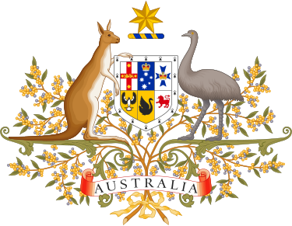

COUNTRY FACTORS
Cultural Factors
  Aesthetic
    Minimalistic and Eco-friendly design
    Craftsmanship
  Symbols
    National symbols
    Cultural symbols
  Colors
    Green
    Gold
  Preferred Flavors
    Hemp
    Recycled Cotton
Laws in Australia
  Competition and Consumer Act 2010 [CCA]
  Australian Consumer Law [ACL]

Slide 14
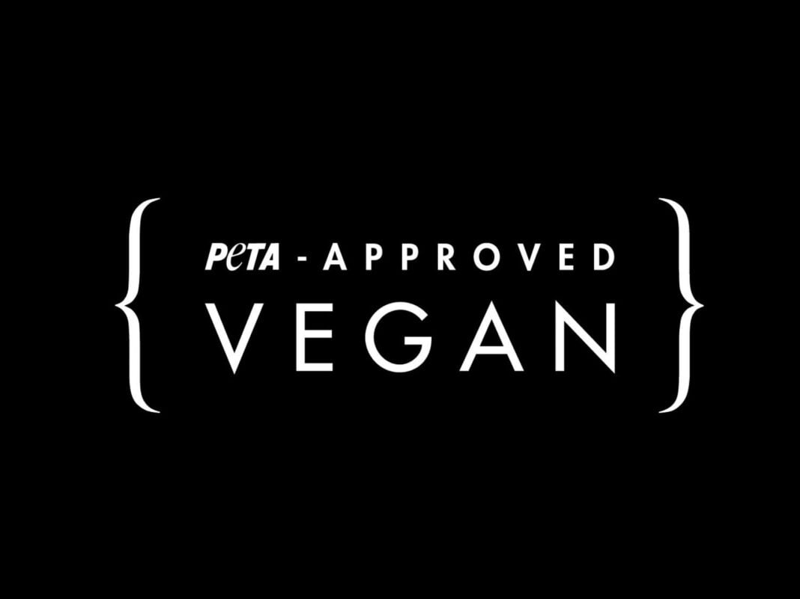
Flavor Changes
  Hemp, Recycled Cotton
  Preference to Australian customers
Packing Changes
  Minimalist and eco friendly
RISK FACTORS
Intellectual Property: To mitigate this risk, ensure that your designs, logos, or any unique aspects of our products are properly trademarked or copyrighted in Australia. Additionally, consider legal advice to understand the country's IP laws thoroughly.
Product Liability: Implement rigorous quality control measures to ensure the safety and quality of our products. Obtaining liability insurance specific to the Australian market is crucial. Ensuring that our products comply with Australian safety standards is also essential to mitigate this risk.
Currency Risk: To manage fluctuations in currency values, consider using financial instruments like forward contracts or options to hedge against potential currency volatility. Diversifying our supplier base or negotiating stable pricing agreements can also help mitigate currency risks.
Labelling Changes
  Certified Logo
  Tag labels
Product Design Changes
  Craftsmanship
Shipping Changes

Slide 15
MODIFIED PRODUCT
Packing Changes
  Minimalist and eco friendly
Flavor Changes
  Hemp, Recycled Cotton
  Preference to Australian customers
Labelling Changes
  Certified Logo
  Tag labels
Product Design Changes
  Craftsmanship
Shipping Changes

Slide 16
MARKETING LUXEVEGAN COUTURE
IDENTIFYING TARGET
AUDIENCE
SUSTAINABILITY &
BRAND ETHICS
BRANDING
Even though we are a new player in the Australian fashion market, we have a well-established heritage and brand value in Canada. And we find Australia as a potential market, and we believe within a short period of time we could take over the luxury segment because of the absence of and exclusive line of products or luxury vegan brands in Australia.
As we are a forward vegan luxury brand who value exclusivity, quality and sustainability our main focus is for a premium line of customers. We think our ideas and style appeal more to our fashion conscious and elite customers who want to enjoy luxury goods without any guilt of harming the environment.
Even though we are a luxury brand we value sustainability, and our main goal is to provide the most premium design in a sustainable way without any compromise in quality and design. So with this moto we will be able to find the right audience.

Slide 17
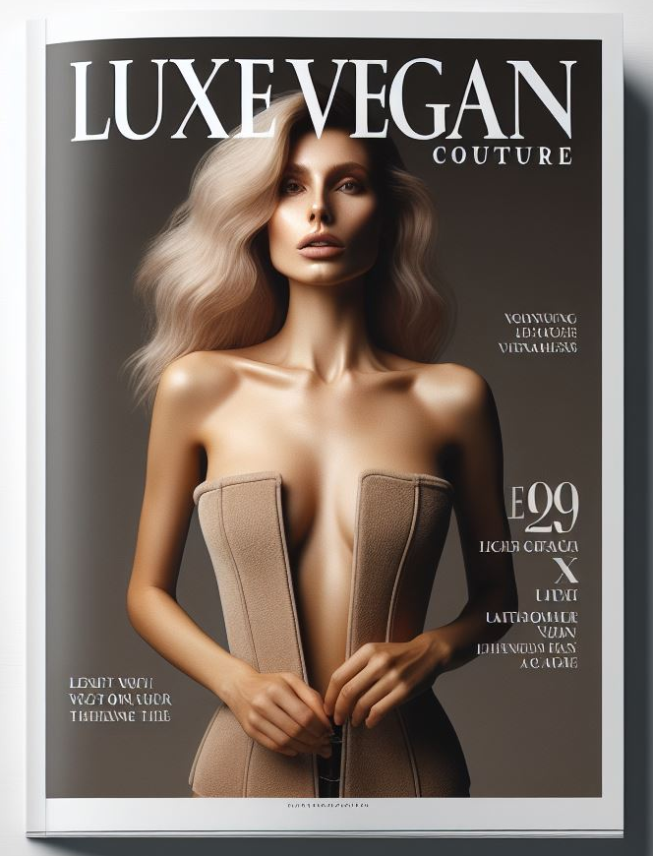
ADVERTISEMENT

Slide 18
CONCLUSION
The viability of luxury vegan clothing in the Australian market appears promising. The increasing awareness of ethical fashion, the rise in veganism, and the growing concern for sustainability all contribute to a favorable environment for such products.
Australia’s fashion industry is receptive to innovative and ethical brands, and with the right marketing strategies, a luxury vegan clothing brand like LuxeVegan Couture could find a niche market among environmentally conscious consumers who are willing to invest in high-quality, sustainable, and cruelty-free fashion.
Moreover, the luxury segment of the market often leads trends in the fashion industry, and with the global shift towards more ethical consumption, luxury vegan clothing could set a precedent for mainstream brands to follow.
In conclusion, considering the current market trends and consumer behavior, luxury vegan clothing has the potential to be successful in the Australian market, provided that the brand can effectively communicate its value proposition and build a strong connection with its target audience.

